Slide 1
Heart Disease Prediction
By Team Omega:-
Danish Faisal
Sai Karthik
Hariprasad

Slide 2
Outline
Introduction
Objectives of research
Problem Statement
Data Collection
Figures
Methodology
Results
Conclusion

Slide 3
Introduction
Heart disease is a leading cause of morbidity and mortality worldwide .
As failure to recognize a typical representations of such serious illness may lead to adverse outcomes, accurate diagnosis is crucial to ensure that patients are placed on the proper treatment pathway.
Electronic medical records (EMR) can be used to improve the diagnosis ability along with measuring the quality of care.
The rapid adoption of EMRs along with the necessity to enhance the quality of health care has incentivized the development of predictive modeling in the medical domain.

Slide 4
Objectives of Research
Automatic identification of heart disease risk factors in clinical narratives can expedite disease progression modelling and support clinical decisions.
Existing practical solutions for cardiovascular risk detection are mostly hybrid systems entailing the integration of knowledge-driven and data-driven methods, relying on dictionaries, rules and machine learning methods that require a substantial amount of human effort.

Slide 5
Problem Statement
Early detection of heart failure Onset of HF is associated with a high level of disability, health care costs, and mortality (roughly 50% risk of mortality within 5 years of diagnosis).
There has been relatively little progress in slowing the progression of this disease, largely because it is difficult to detect before actual diagnosis.
As a consequence, intervention has primarily been confined to the time period after diagnosis, with little or no impact on disease progression.

Slide 6
Data Collection
This directory contains 4 databases concerning heart disease diagnosis.
All attributes are numeric-valued. The data was collected from the
four following locations:
1. Cleveland Clinic Foundation (Cleveland. Data)
2. Hungarian Institute of Cardiology, Budapest (Hungarian. Data)
3. V.A. Medical Center, Long Beach, CA (long-beach-va.data)
4. University Hospital, Zurich, Switzerland (Switzerland. Data)

Slide 7
Attributes
Age
Sex
Chest pain type
Resting blood pressure
Serum cholesterol in mg/dl
Fasting blood sugar
Resting electrocardiographic
Maximum heart rate
Exercise induced angina.
Oldpeak
Slope of the peak
Number of major vessels
Thal
Number of Instances:
Database:
Cleveland: 303
Hungarian: 294
Switzerland: 123
Long Beach VA: 200

Slide 8
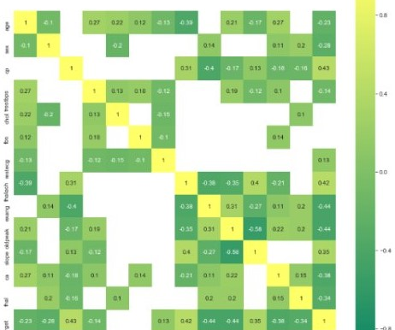
Figures
Correlation Matrix

Slide 9
Methodology
Recurrent Neural Network
A recurrent neural network is a class of neural networks specialised for processing sequential data.
Unlike the CNN, the RNN uses are current layer to learn the representation of clinical data.
In order to implement RNN ,LSTM is used.
The input to an LSTM units is a sequence of length 11 containing the 13 attributes, denoted by a matrix (batch_size,11,13).
Next in the model are 3 hidden layers first two of size 100 and the last hidden layer of size 50 each with ‘relu’ activation function and 20% dropout to prevent over fitting.
The output layer consists of a single node with ‘sigmoid’ activation function.

Slide 10
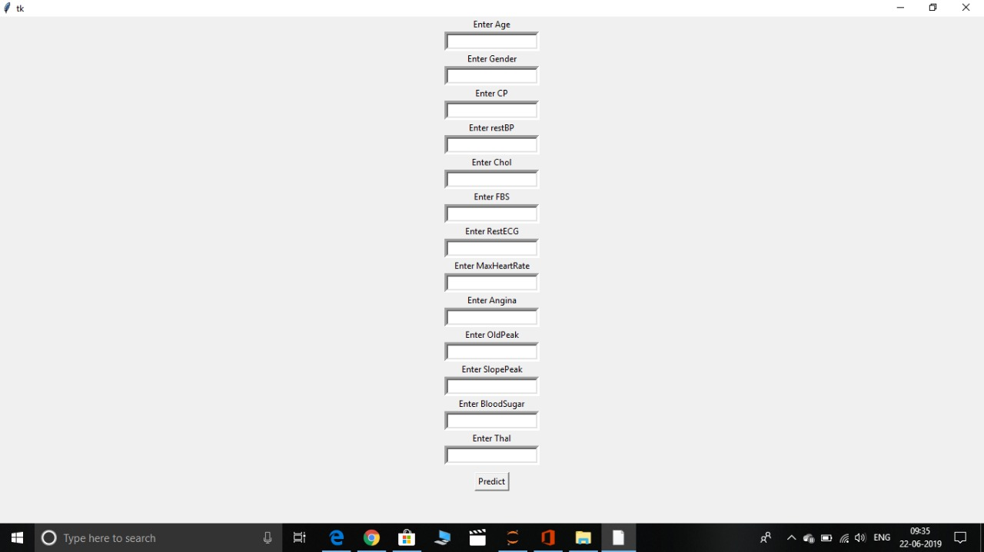
Results

Slide 11
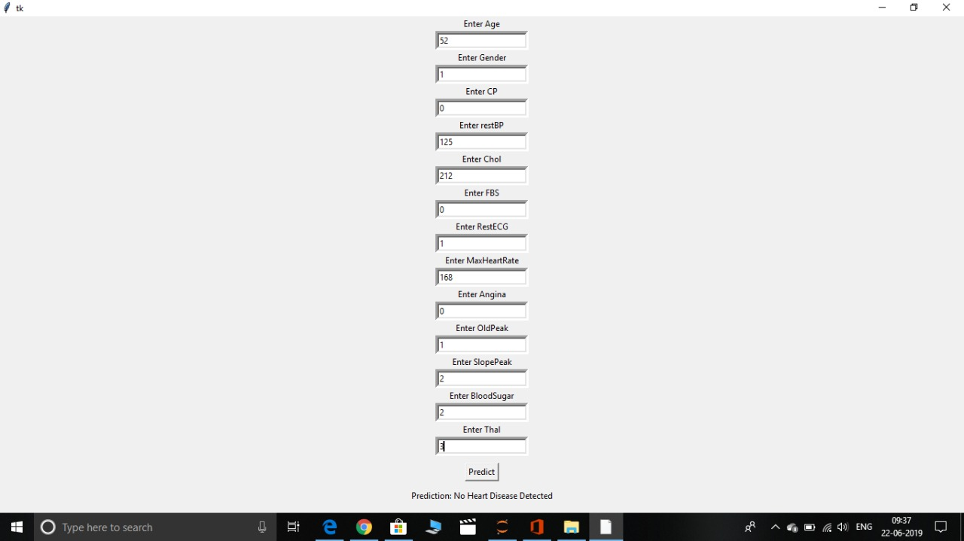

Slide 12
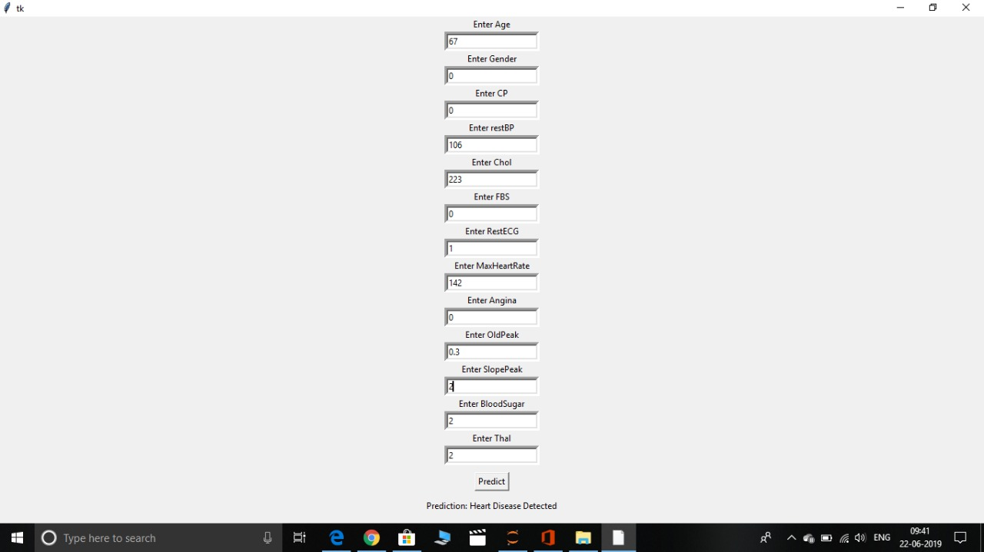

Slide 13
Conclusion
This work empirically evaluated the performance of different deep learning architectures for identifying risk factors for heart disease in clinical text.
The experimental results showed that the deep learning approaches were not only comparable to highly feature-engineered hybrid systems but most importantly achieved relatively high performances without the help of any knowledge-driven methods.
The ﬁndings leads to an anticipation that leveraging knowledge-based approaches with the LSTM model could potentially provide signiﬁcant performance improvements over best systems for extracting key cardiac risk factors from EMRs.

Slide 14


Slide 15


